Slide 1
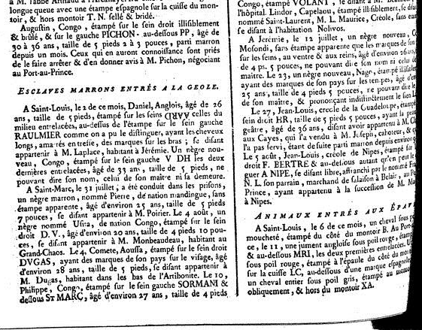
Runaway Slaves in Saint-Domingue Prisons:
Origins & Destinations
Rachel Yales
Senior Thesis: Fall 2013
Atlantic World Slave Database Conference

Slide 2
The Project
Aims to shed light on the maroons of Saint-Domingue
Particularly in terms of African origin & movement within the colony
Exploring possibilities of geospatial analysis
Database containing:
12,912 unique slaves (13,337 total)
3,363 unique non-slaves (3,790 total)
10,356 arrested prisoners
11,260 slaves with ethnic designation
All but ~200 have been identified
5,497 slaves include information about arrest or owner’s location

Slide 3
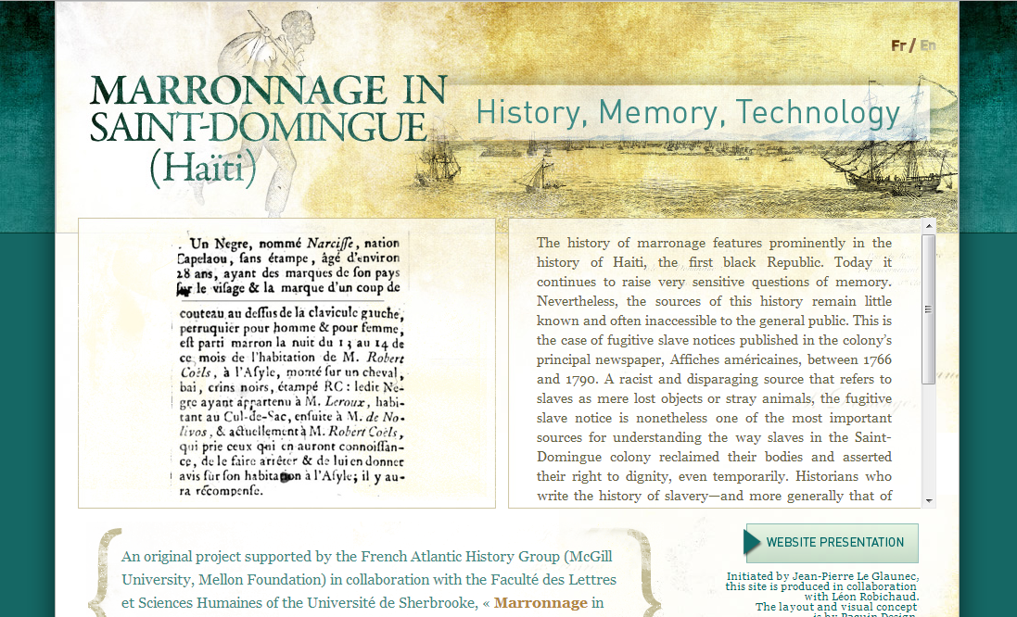
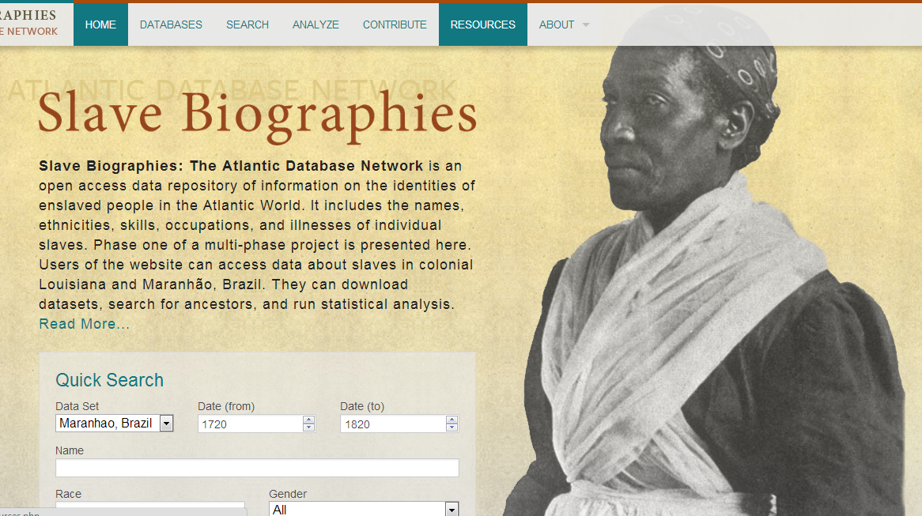
Why This Project?

Slide 4
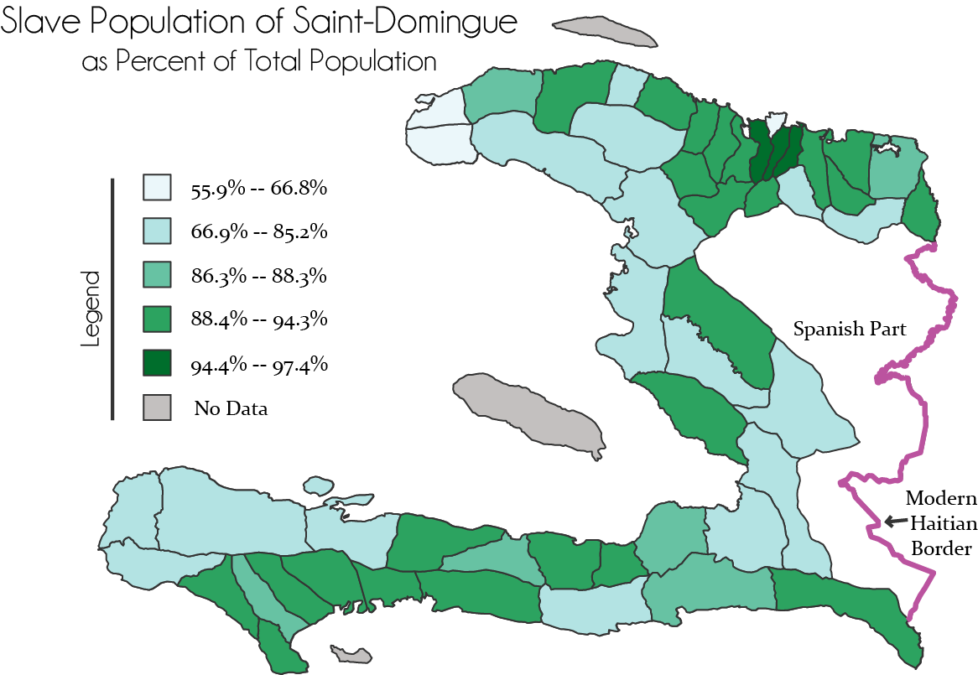
Why This Project?
1789
Data from
Moreau de Saint-Méry’s Description

Slide 5
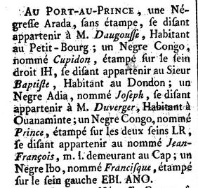
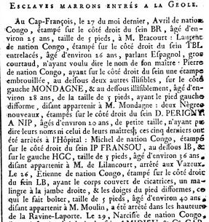
Les Affiches Américaines
Published in Cap-Français & Port-au-Prince from 1766-1791
General notices for colonists, including runaway slave ads & lists of captured runaways being held in prisons
Jean-Pierre Le Glaunec has made the runaway ads available to the public
Prison lists examined by Jason Daniels (2012), but data is not complete & unavailable online
Debate over the role of maroons & marronage in the Haitian Revolution
Much is still to be learned from these documents

Slide 6
Prison Law
Ordinances outlining rewards & procedures
Questions asked of received slaves to be entered in les Registres du Greffe
Name, owner, description, brand
Self-identified ethnicity
Required by law to be published in Les Affiches Américaines & at local parish church
Special rewards for those slaves captured in Santo-Domingo

Slide 7
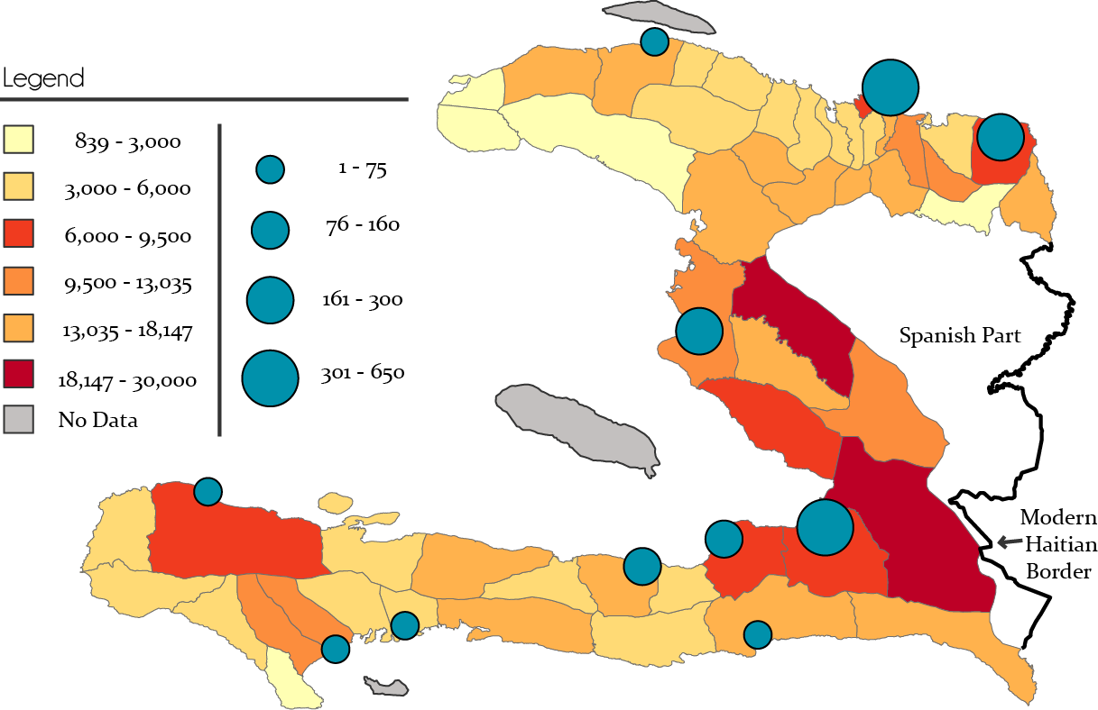
Prison Numbers

Slide 8
Designing the Database
The individual slave as primary unit
Two-tier design:
Basic demographic collection
Name, race, ethnicity, age, date, location
Detailed collection of non-standardized information
Physical description, illnesses, brands, stolen items, family members, skills, owners, reasons for marronage
Allows basic analysis to be completed earlier, with opportunity to return for more details
At this point, records from 1766-1768 are “complete,” while those from 1780s have basic demographics only

Slide 9
Tailored to the Sources
Easily adaptable to standardized slave database, but additional fields fit the specific type of data in the documents
Original fields based off Atlantic Slave Biography’s design
Added fields unique to marronage records & according to geographic research interests
Evidence of punishment | Chains
Claiming to be free | Escape date/location
Prison entry date/location | Could/would not name master, self, or nation
Arrest location | Suspect location

Slide 10
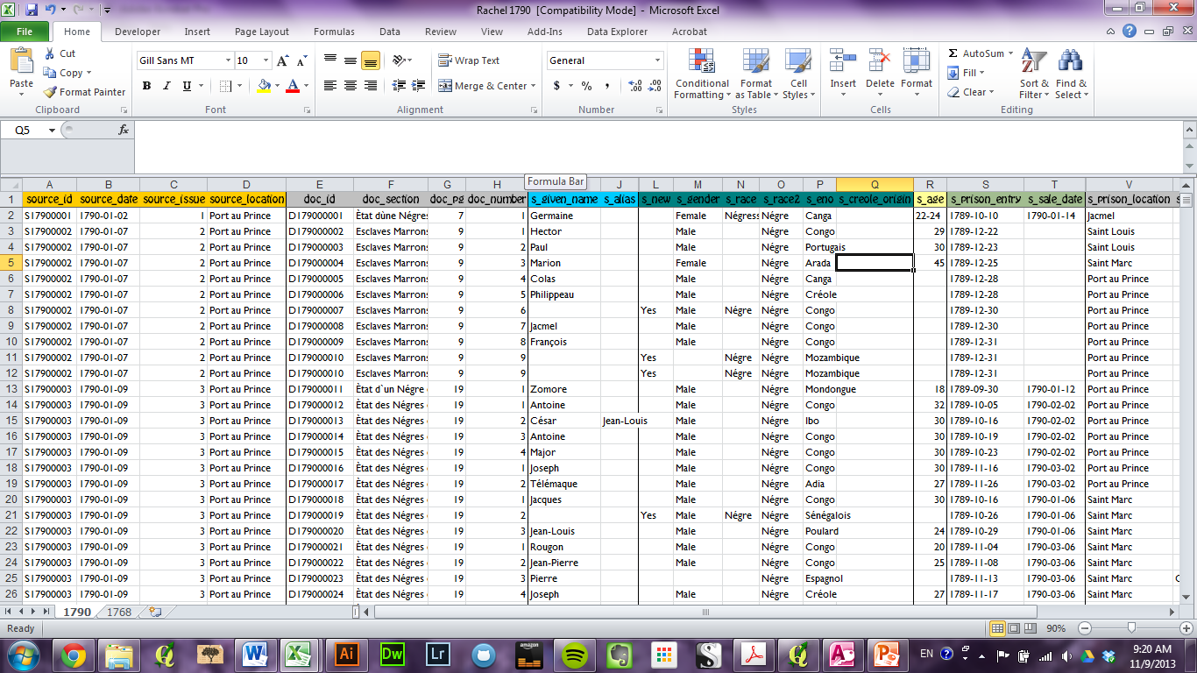
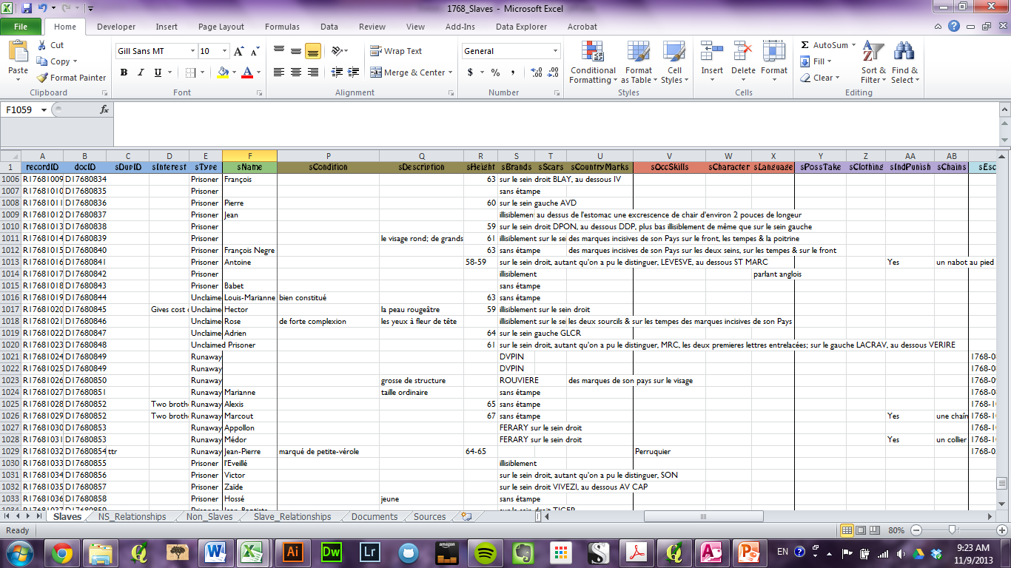

Slide 11
Identifying Repeat Runaways
Apr 1767: un Negre créole, nommé Lubin, étampé sur le sein droit L. CH. D. LA CROIX, se disant appartenir à M. de Monts, Officier de la Légion, demeurant à l'Acul
Feb 1768: le 29, un Negre créole, nommé Lubin, étampé sur le sein droit L. CH. LA [cross], se disant appartenir à M. Courresoles
Nov 1767: Au Fort-Dauphin…un Negre Sénégalois, nommé Pierre, étampé sur le sein droit SORBIERE. AV CAP, taille de 5 pieds 3 à 4 pouces, se disant appartenir à M. Sorbiere, demeurant au Cap
Feb 1771: [Le Cap,] Pierre, Sénégalois, étampé sur le sein droit SORBIERE, et au dessous AU CAP, et plus bas HVROST, lequel a dit appartenir à M. Lecomte, Habitant au Limbé

Slide 12
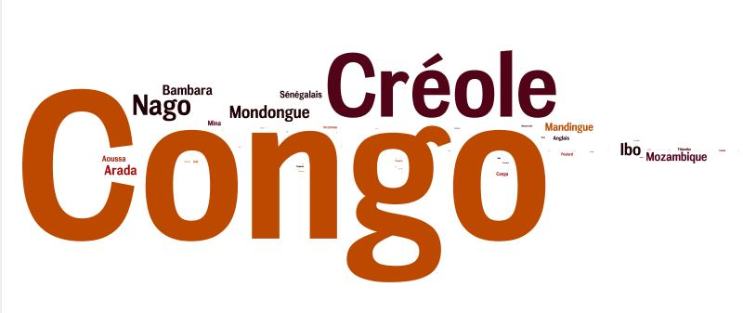
African Ethnic Origins

Slide 13
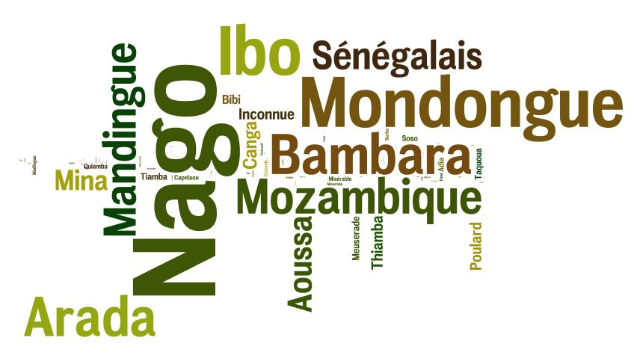
African Ethnic Origins

Slide 14
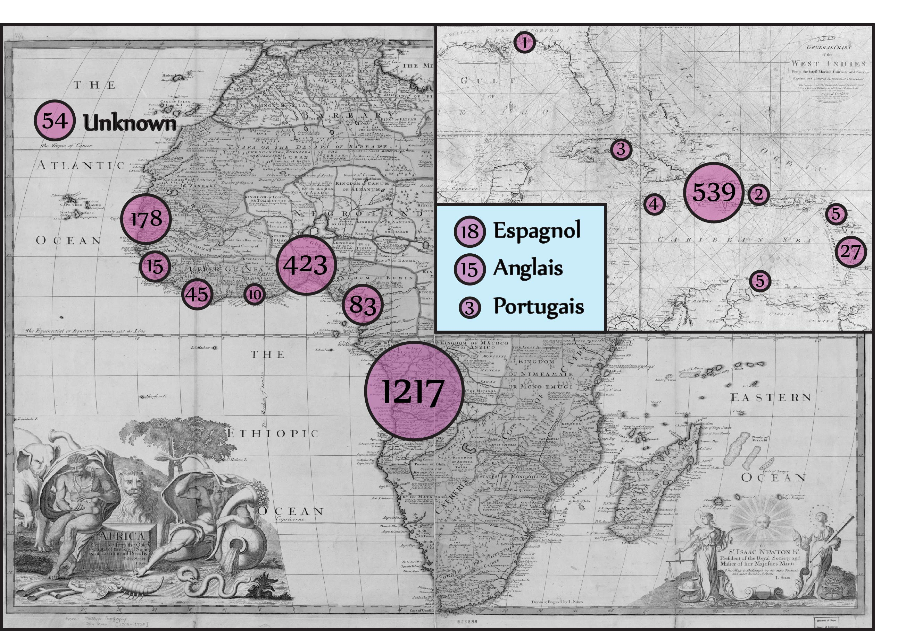

Slide 15
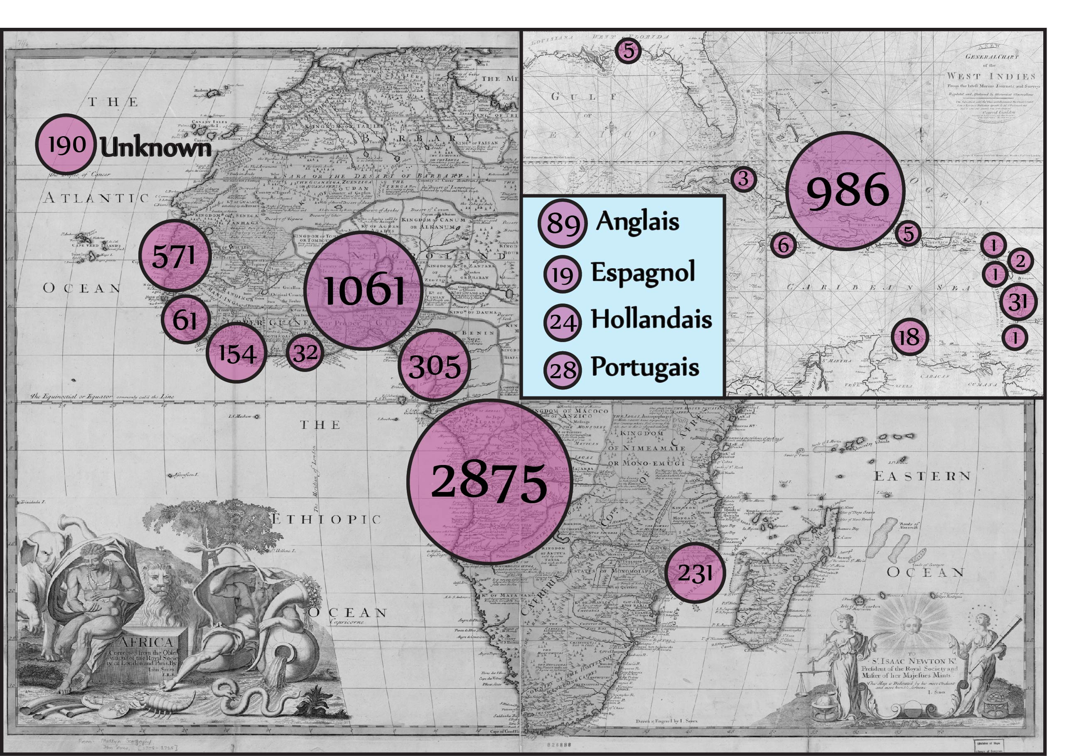

Slide 16
Bringing in Geography
Historical geography is very labor-intensive
Physical:
On-the-ground observation, surveying, & archeology
Digital:
Georeferencing maps, geoparsing/coding locations, transferral into GIS software
Anne Knowles (2008) & Ian Gregory (2008)
Case studies by Jacques de Cauna (2009) & Barry Higman (1988)

Slide 17
The Process
1
2
Researching
Historical
Geography
Data Collection
3
GeoparsingGeocoding
4
5
Analysis
Publication

Slide 18
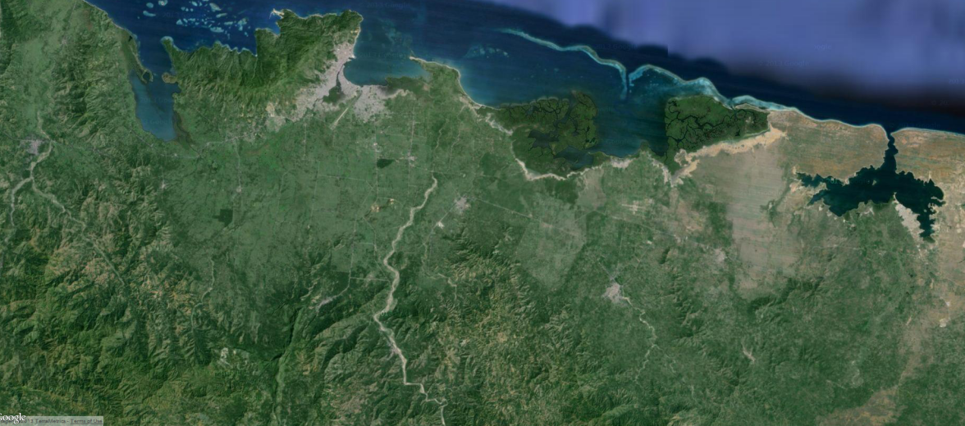
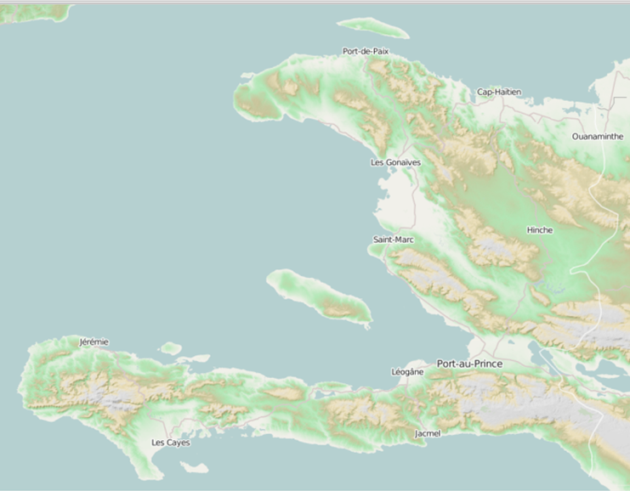
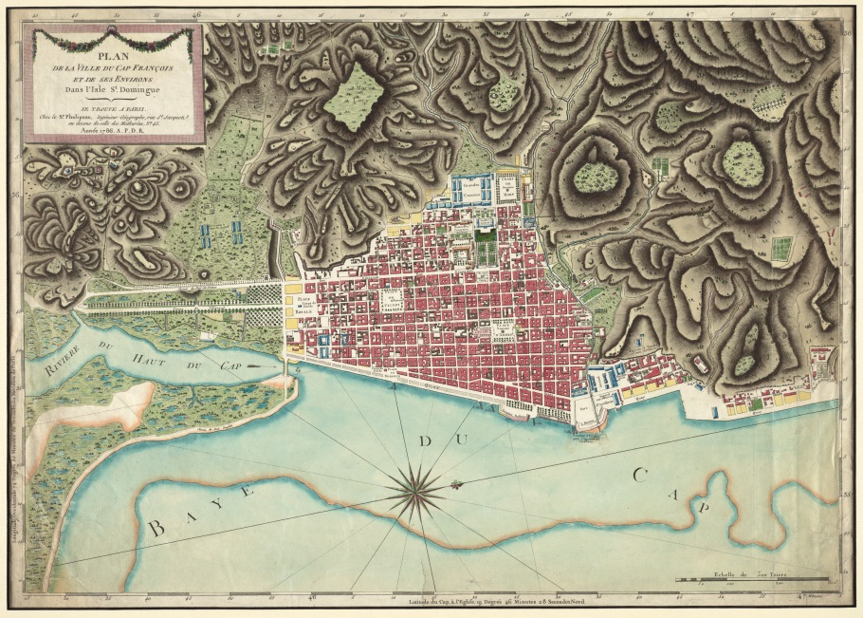

Slide 19
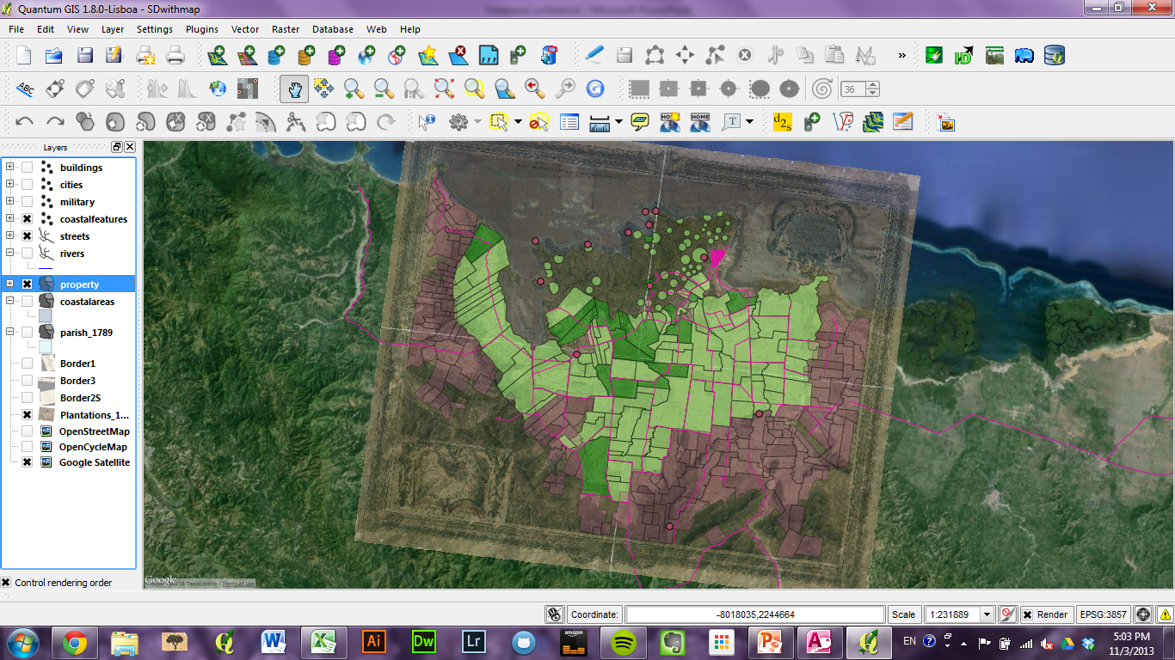
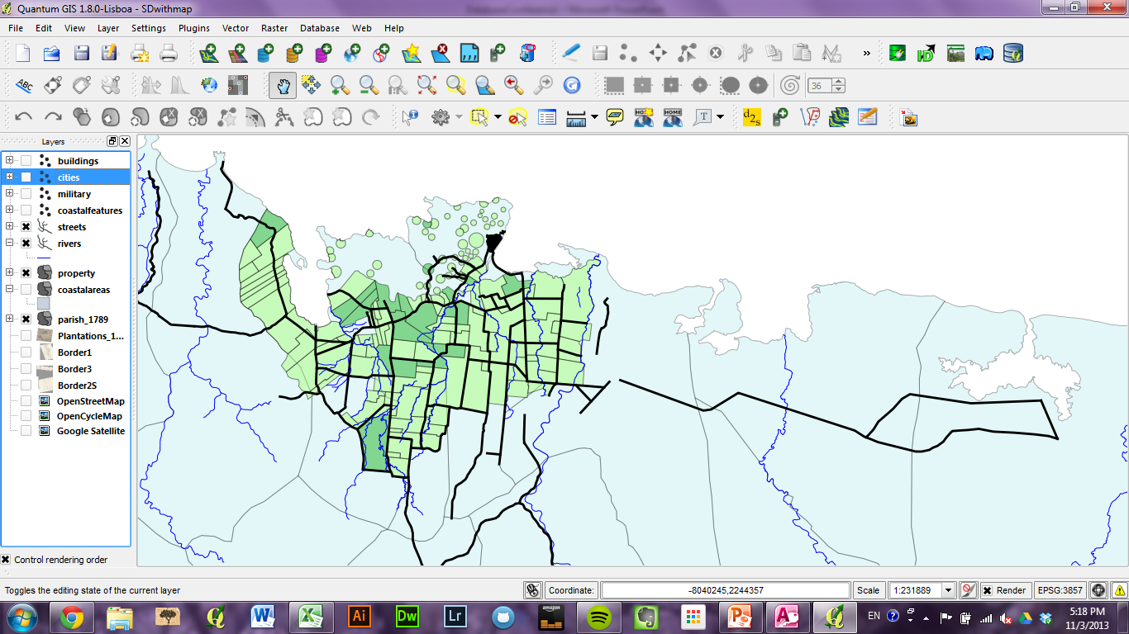
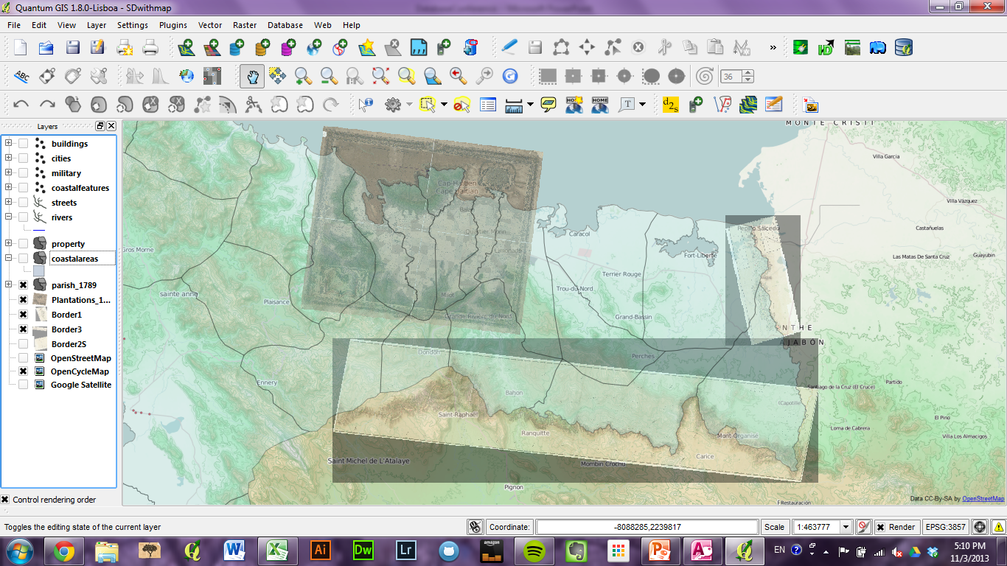
Using GIS

Slide 20
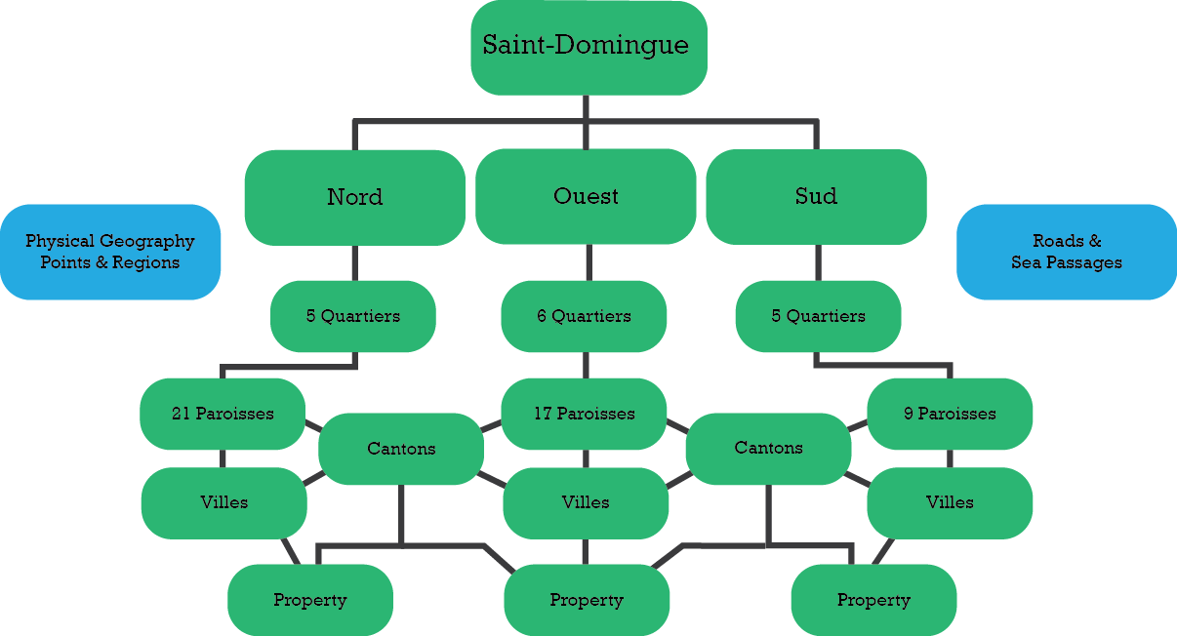
Geocoding Hierarchy

Slide 21
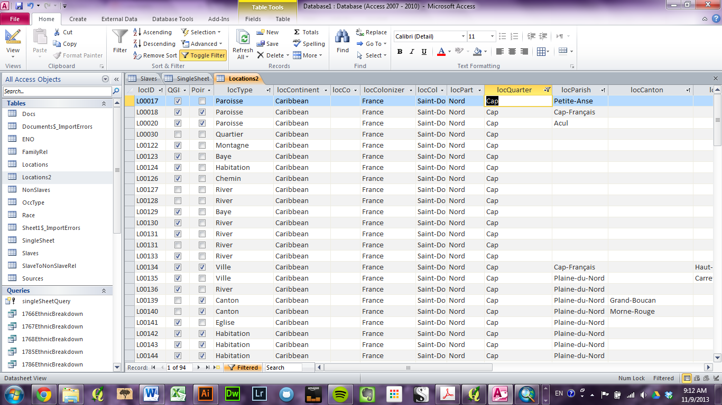
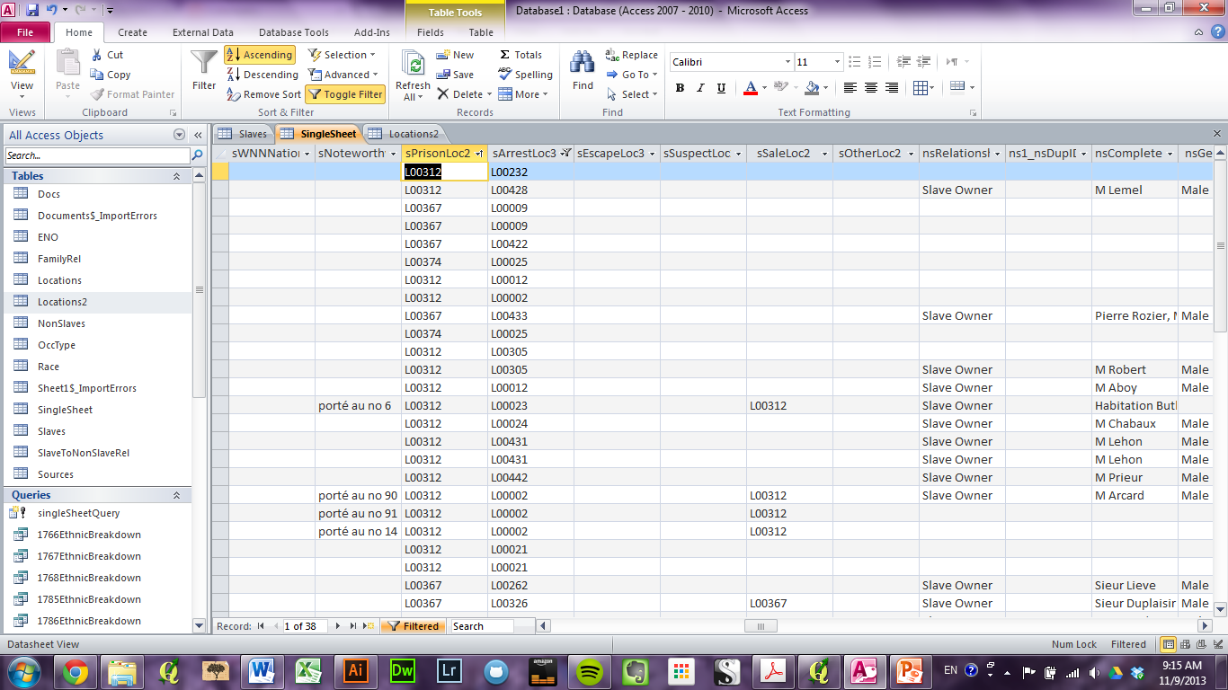

Slide 22
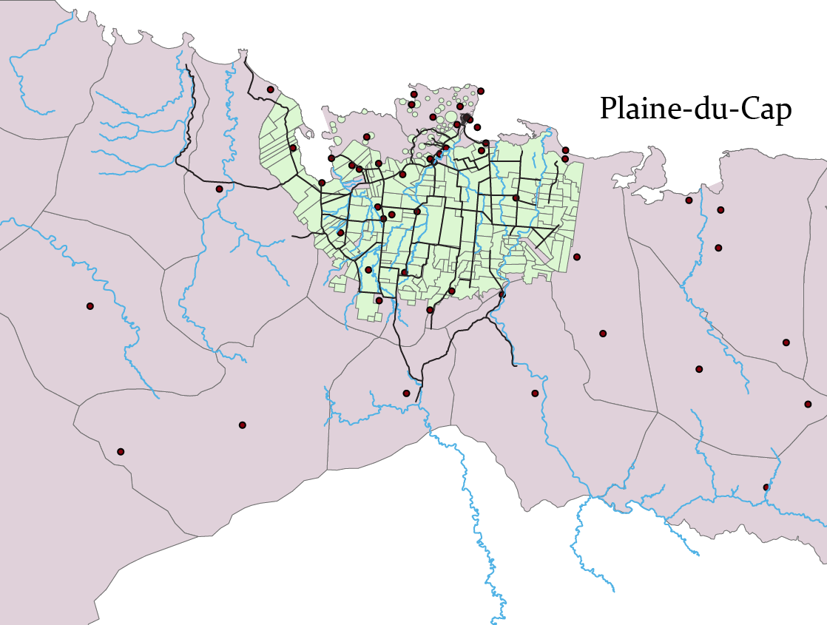

Slide 23
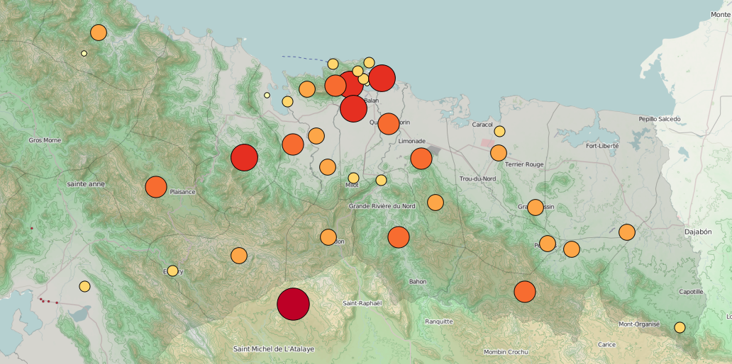
Geographic Analysis

Slide 24
Looking Forward
Potential for databases which integrate information from various types of documents
plantation records, newspapers, maps, almanacs, gazettes, ship manifests, government records, photos, spatial imagery
Allows for analysis of:
Population data (both slave & free)
Migration patterns
Land ownership & use
Physical geography
Changes over time

